Slide 1

TOURISM MANAGEMENT SYSTEM(TMS) (Admin Module)
A
PROJECT PRESENTATION
ON
By
Kumawat Ramkrushna Dnyaneshwar
UNDER
MGSM’S
Dadasaheb Dr. Suresh G. Patil College, Chopda
KAVAYITRI BAHINABAI CHAUDHARI NORTH MAHARASHTRA UNIVERSITY, JALGAON

Slide 2
INDEX
Introduction
Existing System
Need Of The System
Hardware & Software
Features
Diagrams
Data Dictionary
Screens
Test Cases
Conclusion
References

Slide 3
INTRODUCTION
Tourism Management System has been developed to integrate teacher’s of multiple colleges under one platform where Content/Resources will be shared of different different streams.
When required teacher from registered colleges can visit the site and share or download the necessary content.
We made it even easier to find the content as we sort the data as per streams/colleges.
Ex. MSC,ENGINEERING ,MCA ,MBA ,PHARMACY and many more.

Slide 4
EXISTING SYSTEM
Before developing Tourism Management System there were no such systems developed.
No such system is observed where faculties can have an access to other colleges resources/content.
So we took the opportunity to build such system which will help teaching fraternity in coming days.

Slide 5
NEED OF THE SYSTEM
To overcome the process of manually sharing of resources.
All the data/resources are computerized so no need of paper work.
As it is computerized availability is 24*7.
Less time consuming.

Slide 6
HARDWARE & SOFTWARE
HARDWARE :
Processor - 1GHz or Higher
RAM - 1GB or more
Hard Disk - 40GB or more
Monitor - Any
SOFTWARE :
Operating System- Windows ,Linux
Front End - HTML5 ,CSS ,BOOTSTRAP, JAVASCRIPT
Back End - PHP, My SQL as database

Slide 7
FEATURES
At one place teachers will have an access to other college’s resources/contents.
One can upload any upcoming event/competition information regarding education to let other’s know about it.
The process of sharing resources is faster than manually sharing data.
Less time consuming compared to manually searching for data.
Responsive design.
No paper work.
Easy and effective to use.

Slide 8
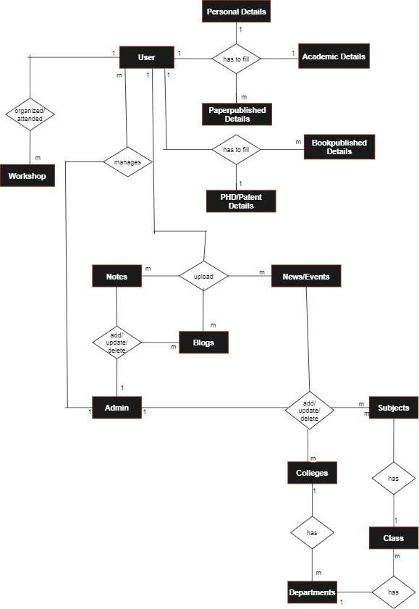
E-R DIAGRAM

Slide 9
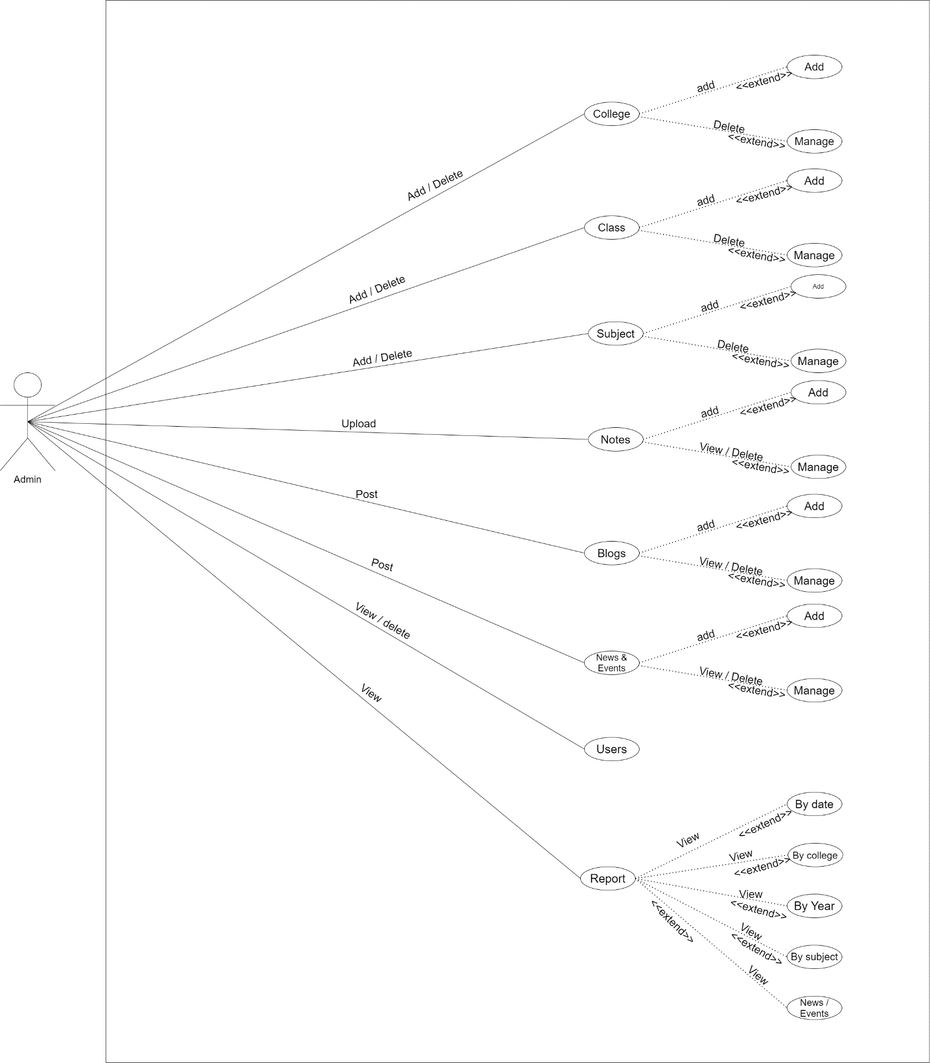

Slide 10
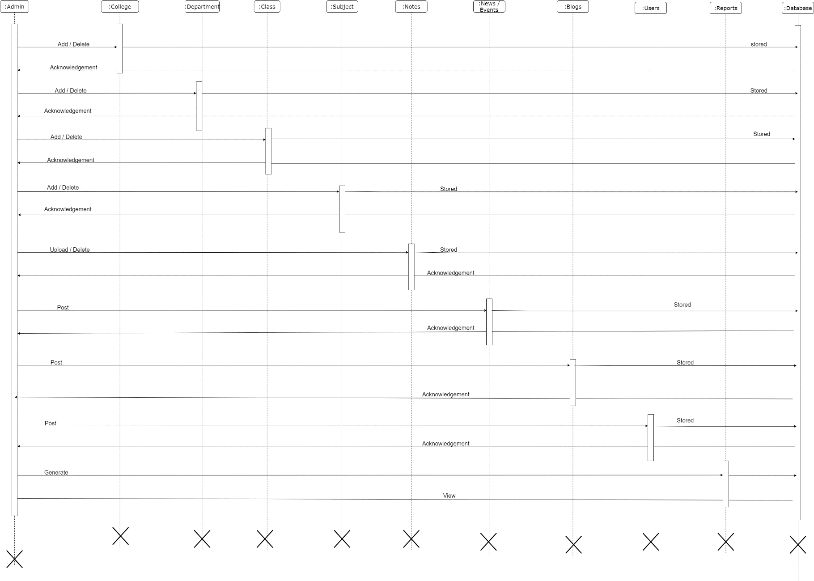
Admin:

Slide 11
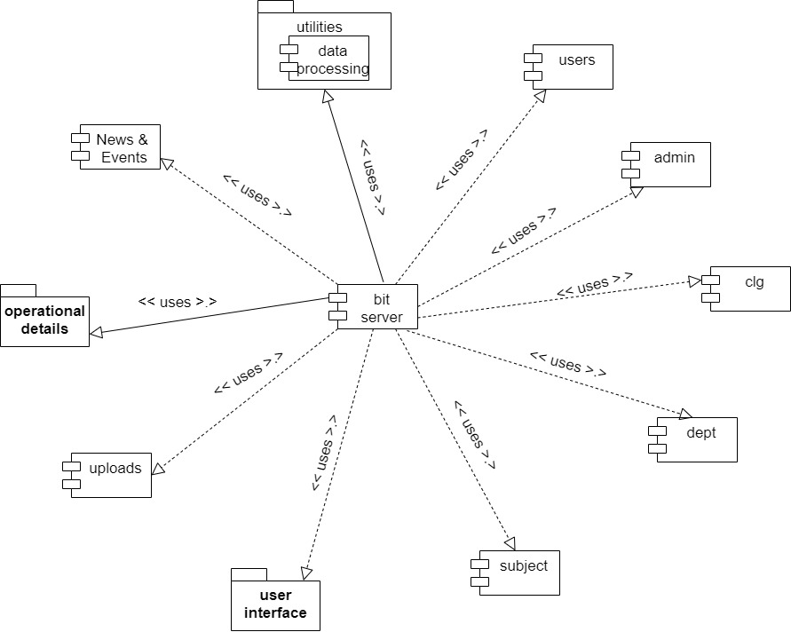
COMPONENT DIAGRAM

Slide 12
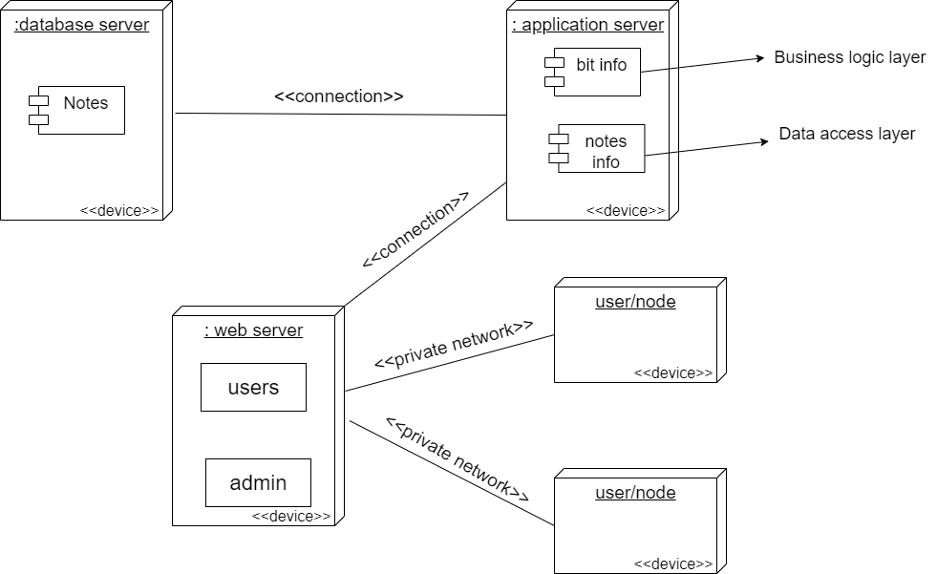
DEPLOYMENT DIAGRAM:

Slide 13
DATA DICTIONARY
ADMIN TABLE:
FIELD NAME | DATA TYPE | SIZE | CONSTRAINT | DESCRIPTION
ID | int | 4 | Primary key Auto Increment | Unique no
UserName | Varchar | 50 |  | Username for login
Name | Varchar | 70 |  | Admin Name
EmailId | Varchar | 50 |  | Email for registration
MobileNumber | Bigint | 10 |  | Active Mobile Number
Password | Varchar | 50 |  | Password for Login
Updationdate | Timestamp |  |  | Date of updation

Slide 14
Table Name :tblbooking
FIELD NAME | DATA TYPE | SIZE | CONSTRAINT | DESCRIPTION
BookingId | Int | 11 | Primary key Auto Increment | Unique ID
PackageId | Int | 11 |  | Package Id
UserEmail | Varchar | 100 |  | User email for login
FromDate | Varchar | 100 |  | Book from date
ToDate | Varchar | 100 |  | Book to the date
Comment | Mediumtext |  |  | Text for quiries
RegDate | Timestamp |  |  | Date of registration
Status | Int | 11 |  | Status of booking
CancelledBy | Varchar | 5 |  | Booking cancelled by user/admin
UpdationDate | timestamp |  |  | Date of Updation

Slide 15
Table Name : tblenquiry
FIELD NAME | DATA TYPE | SIZE | CONSTRAINT | DESCRIPTION
Id | Int | 11 | Primary key Auto increment | Unique No
FullName | Varchar | 100 |  | Name of Inquires
EmailId | Varchar | 100 |  | Email Id of inquires
MobileNumber | Char | 10 |  | Mobail number of inquires
Subject | Varchar | 100 |  | Subject of inquiry
Description | Mediumtext |  |  | Description of enquiry
PostingDate | Timestamp |  |  | Date of posting of enquiry
Status | Int | 11 |  | Status of enquiry

Slide 16
Table Name: tblpages
FIELD NAME | DATA TYPE | SIZE | CONSTRAINT | DESCRIPTION
Id | Int | 11 | Primary key Auto Increment | Unique number
Type | Varchar | 255 |  | Type of page for Changing
detail | longtext |  |  | Detail about page
Table Name : tblissues
FIELD NAME | DATA TYPE | SIZE | CONSTRAINT | DESCRIPTION
Id | Int | 4 | Primary key | Unique number
UserEmail | Varchar | 100 |  | Email of person
Issue | Varchar | 100 |  | Subject of issue
Description | Mediumtext |  |  | Description of issue
PostingDate | Timestamp |  |  | Date of posting of issue
AdminRemark | Mediumtext |  |  | Remark about issue from admin
AdminRemarkDate | Timestamp | 1 |  | Date of remark of issue

Slide 17
Table Name : tbltourpackages
FIELD NAME | DATA TYPE | SIZE | CONSTRAINT | DESCRIPTION
PackageId | Int | 11 |  | Package id
PackageName | Varchar | 200 |  | Name of Package
PackageType | Varchar | 150 |  | Type of package
PackageLocation | Varchar | 100 |  | Package Location
PackagePrice | Int | 11 |  | Package price
PackageFeature | Varchar | 255 |  | Features of package
PackageDetails | Mediumtext |  |  | Details of package
PackageImage | Varchar | 100 |  | Image of package
CreationDate | Timestamp |  |  | Date of package created
UpdationDate | Timestamp |  |  | Date of package updation

Slide 18
Table Name : tblusers
FIELD NAME | DATA TYPE | SIZE | CONSTRAINT | DESCRIPTION
Id | Int | 11 | Primary key | Unique Number
FullName | Varchar | 100 |  | Name of User
MobailNumber | Char | 10 |  | User mobile number
EmailId | Varchar | 100 |  | User email id
Password | Varchar | 100 |  | User password
RegDate | Timestamp |  |  | Date of registration
UpdationDate | Timestamp |  |  | Date of updation

Slide 19
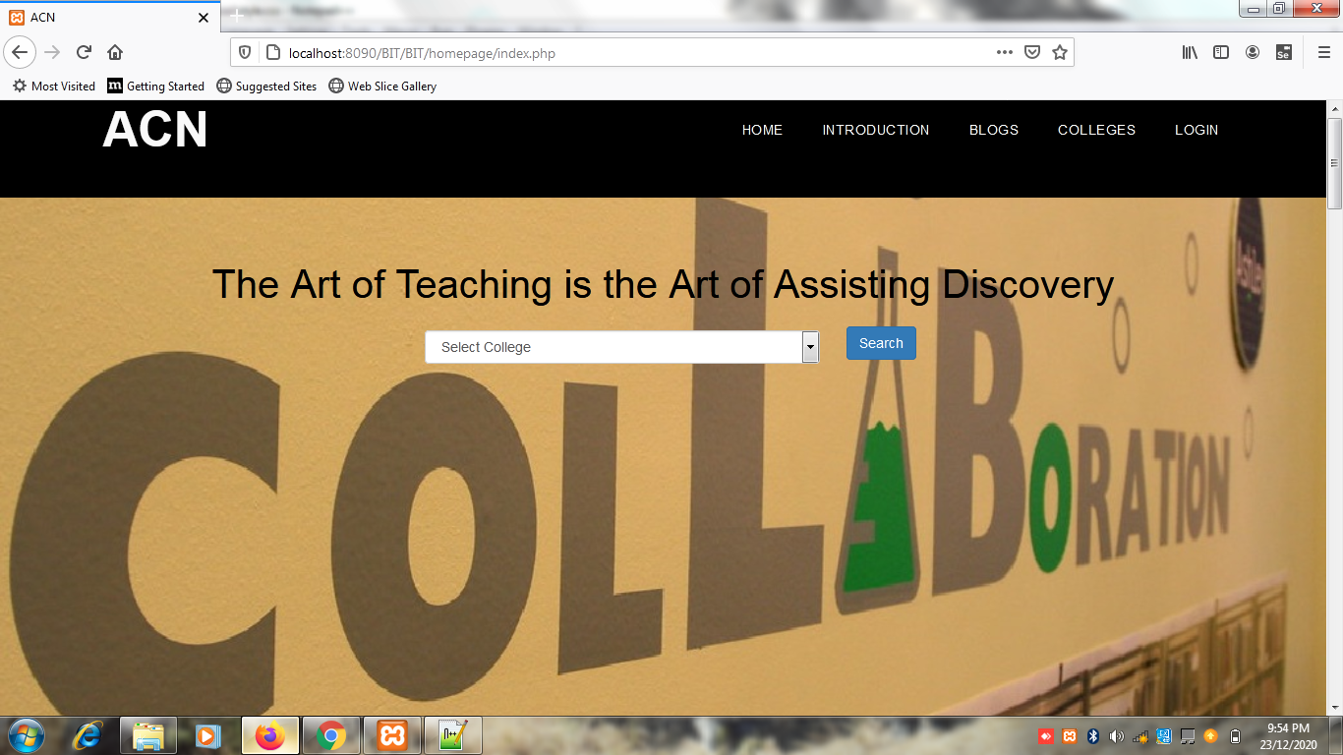
SCREENS:
HOME PAGE:

Slide 20
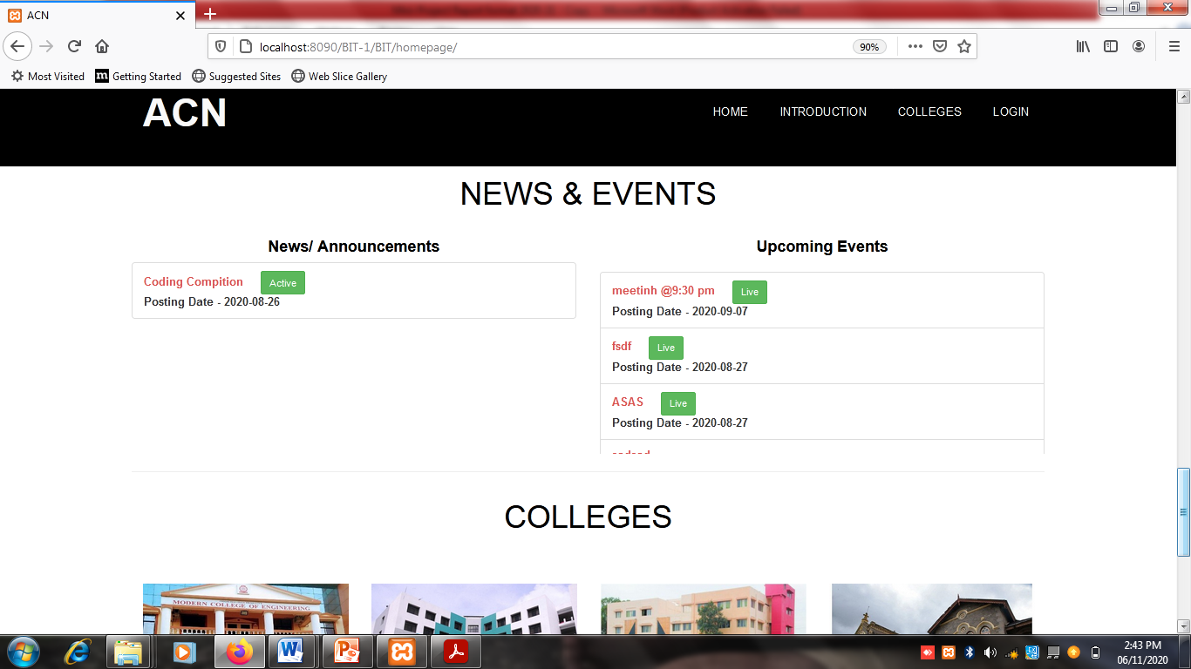

Slide 21
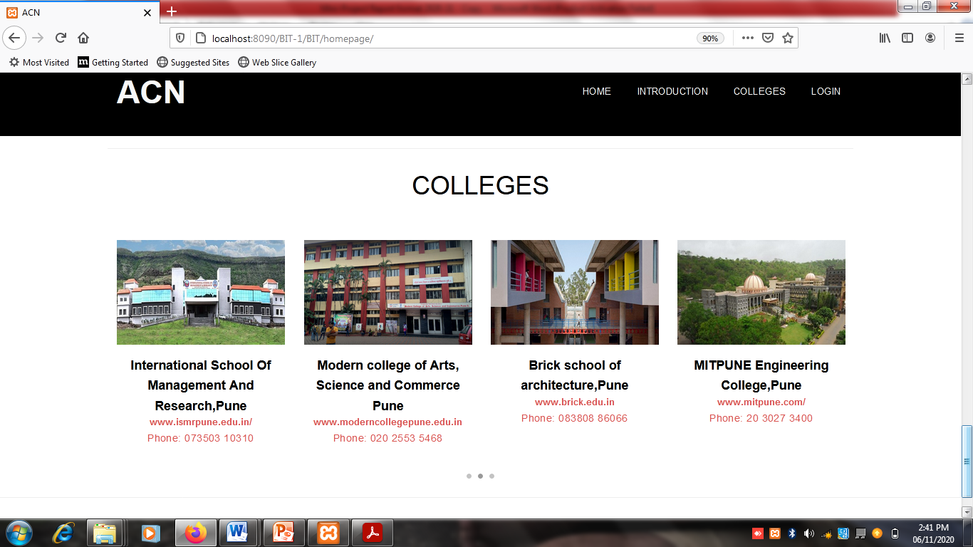

Slide 22
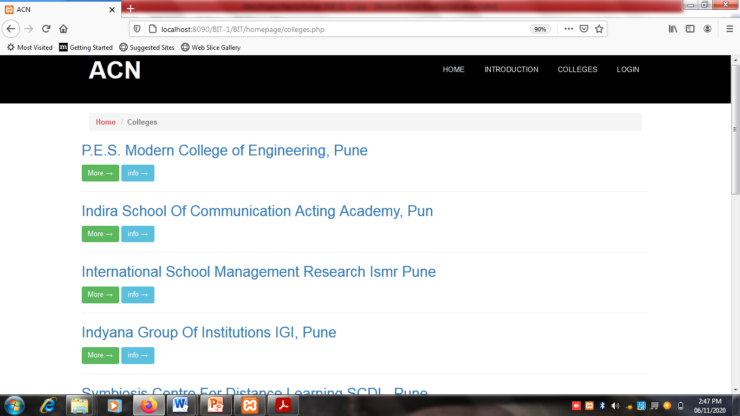
COLLEGES PAGE:

Slide 23
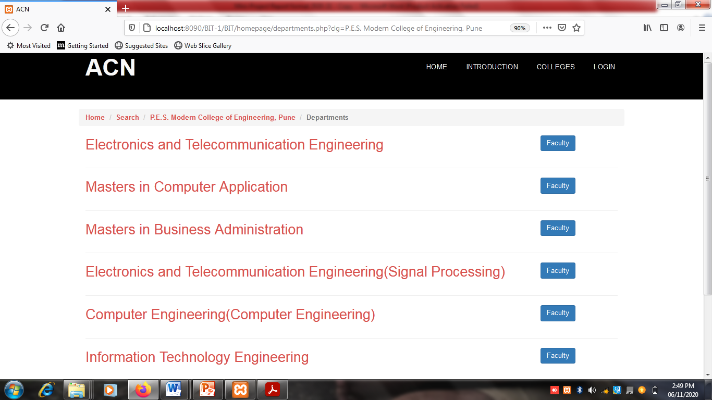

Slide 24
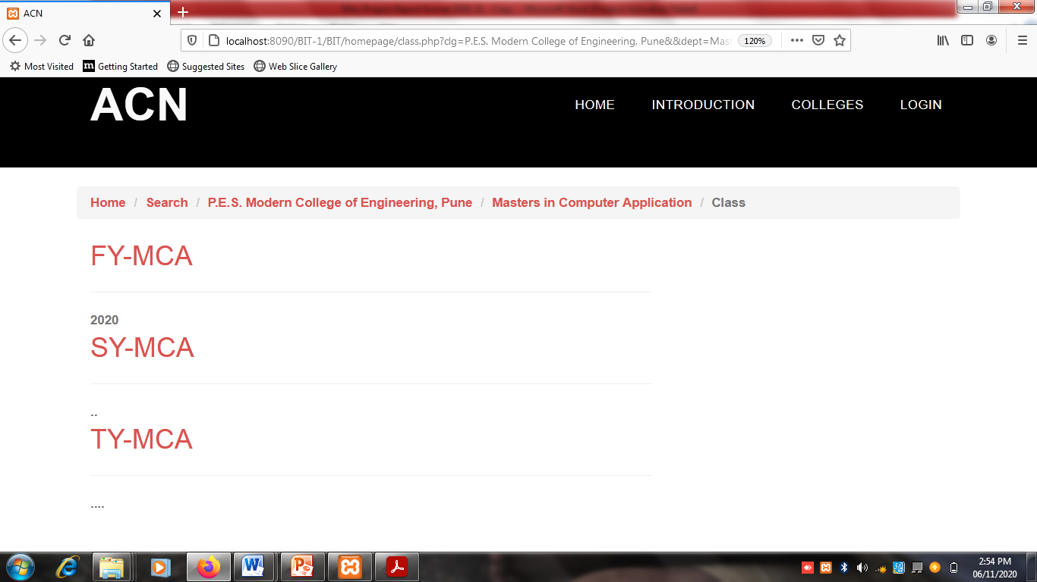

Slide 25
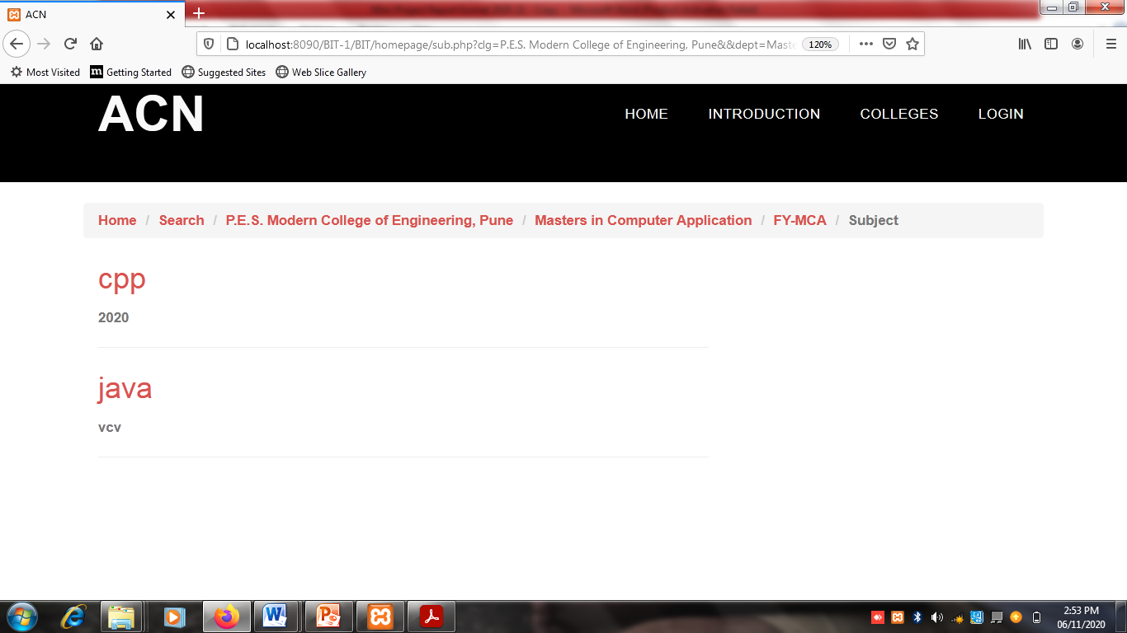

Slide 26
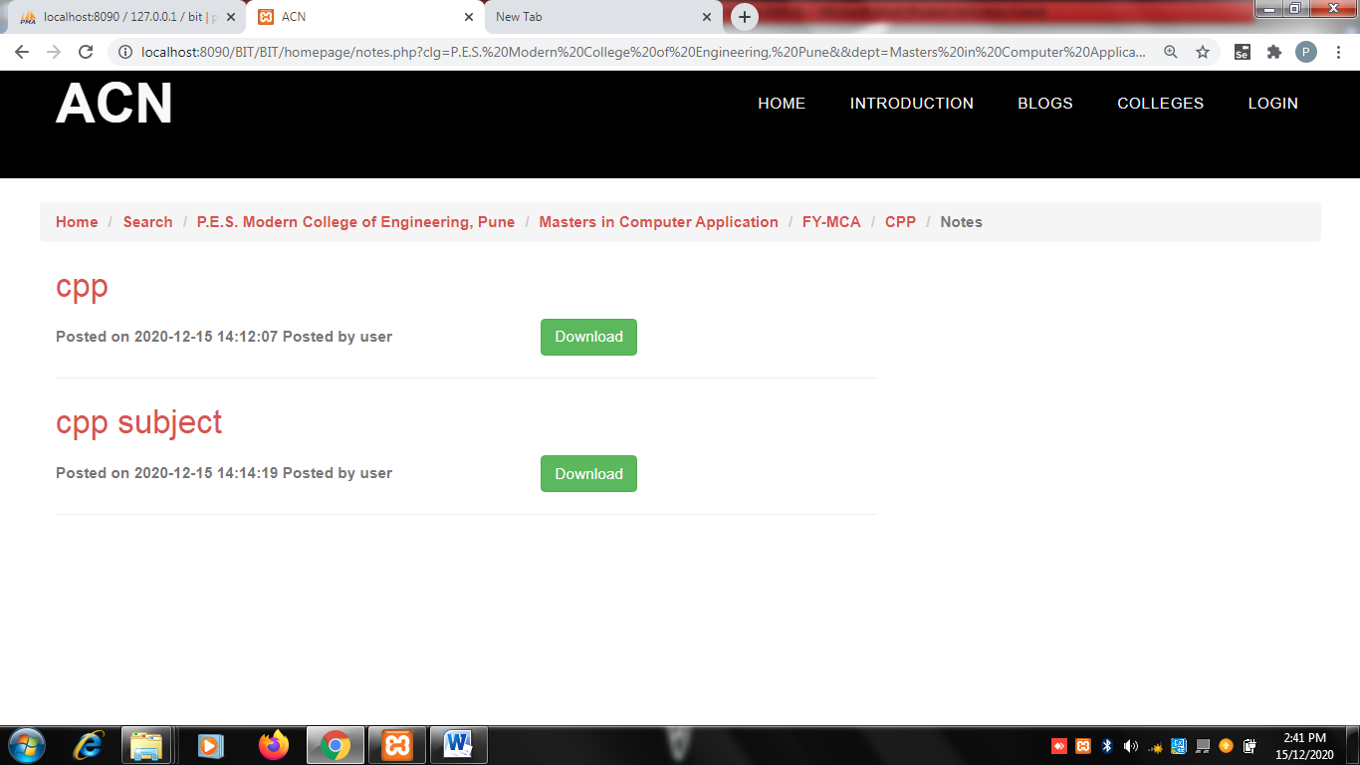

Slide 27
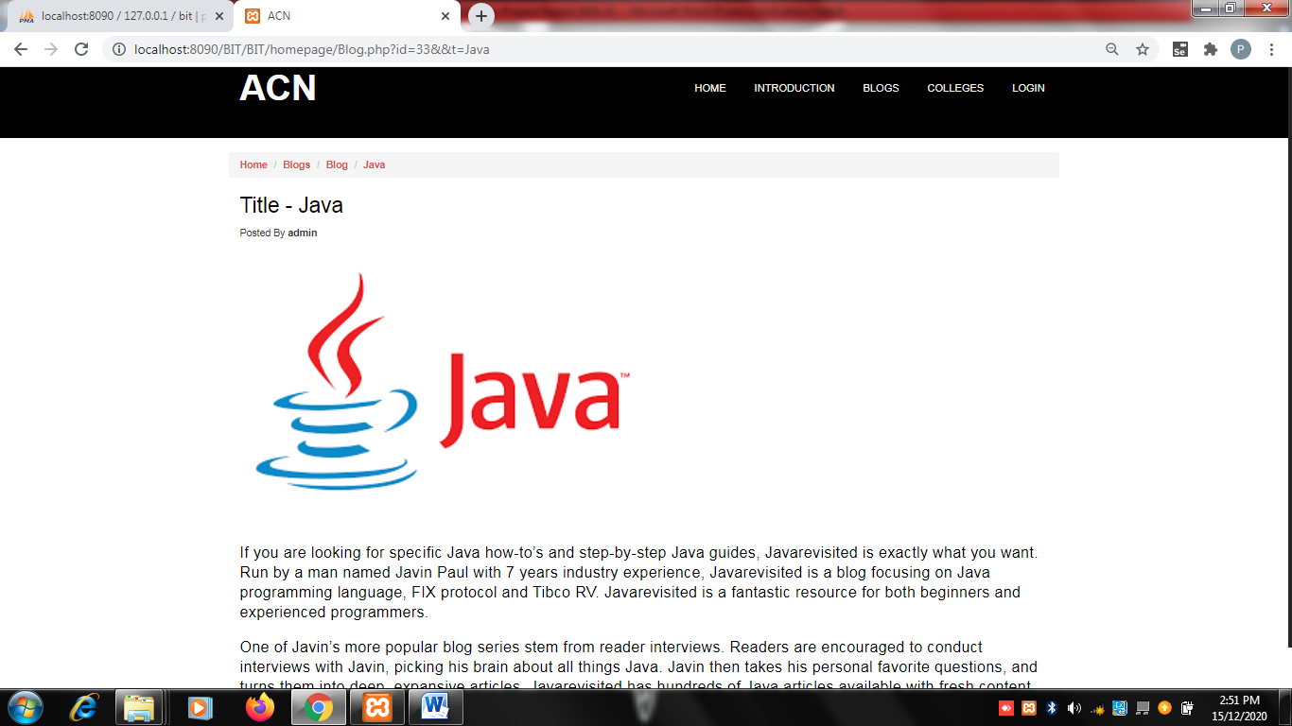
Blogs:

Slide 28
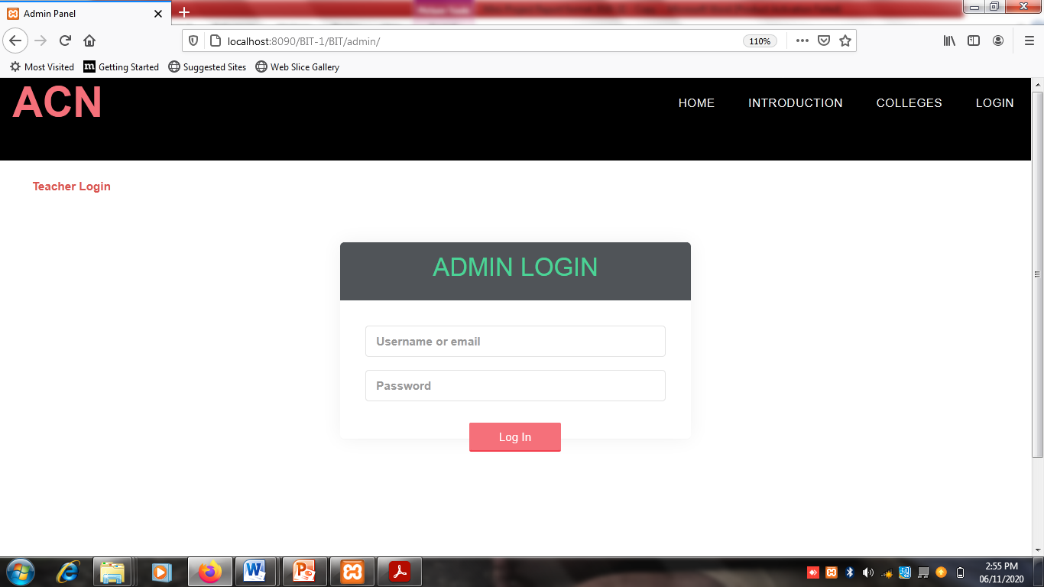
ADMIN PANEL:
ADMIN LOGIN:

Slide 29
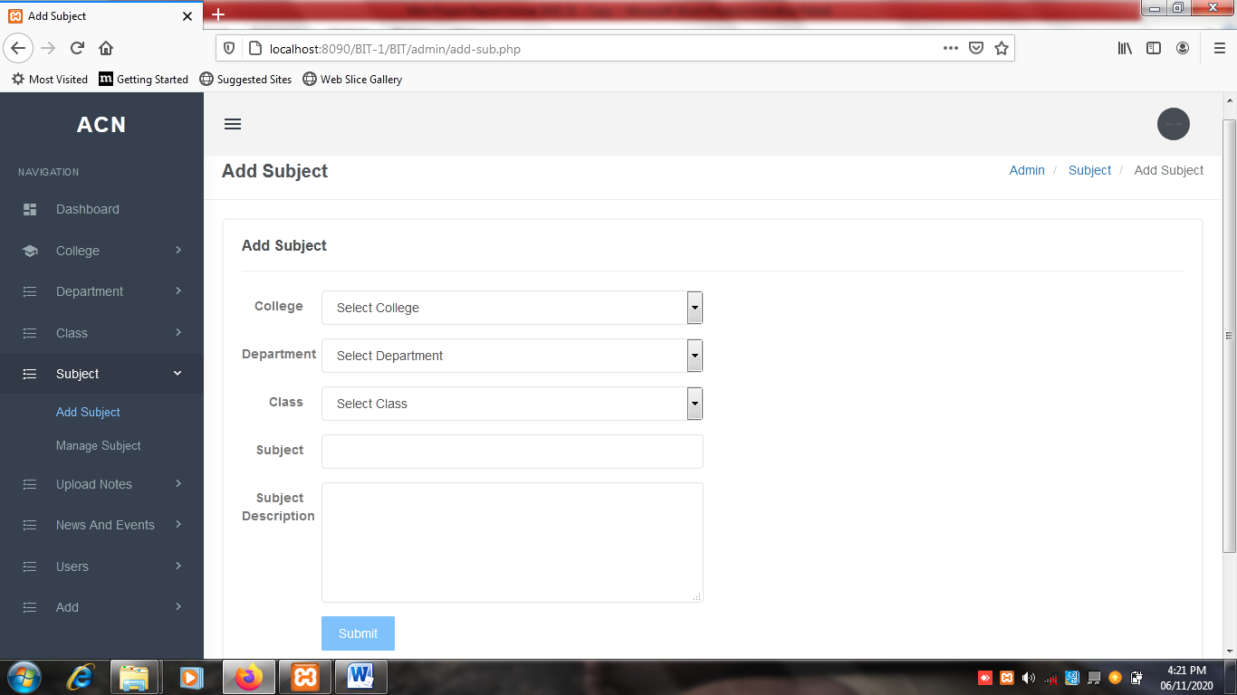
ADD/MANAGE DETAILS OF COLLEGE:

Slide 30
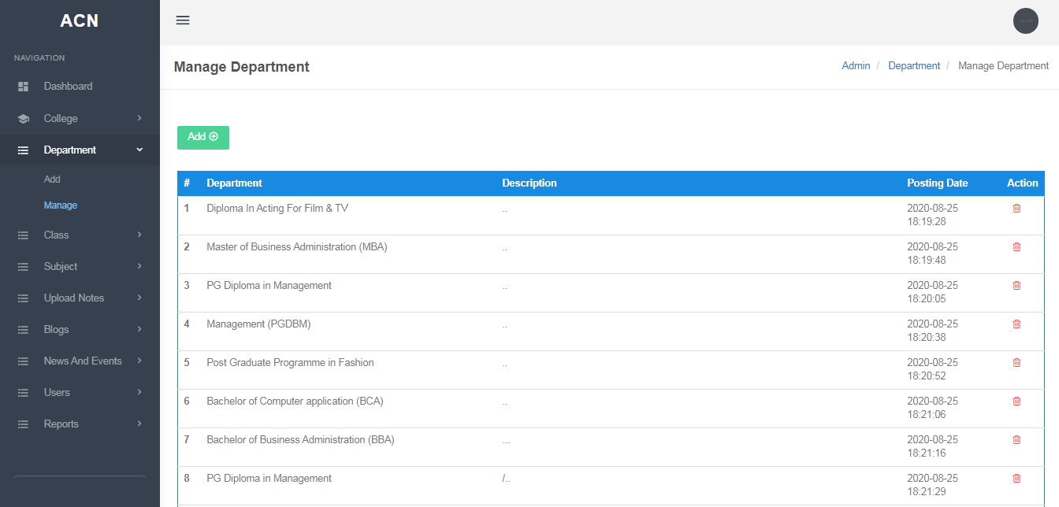
ADD/MANAGE DETAILS OF DEPARTMENT:

Slide 31
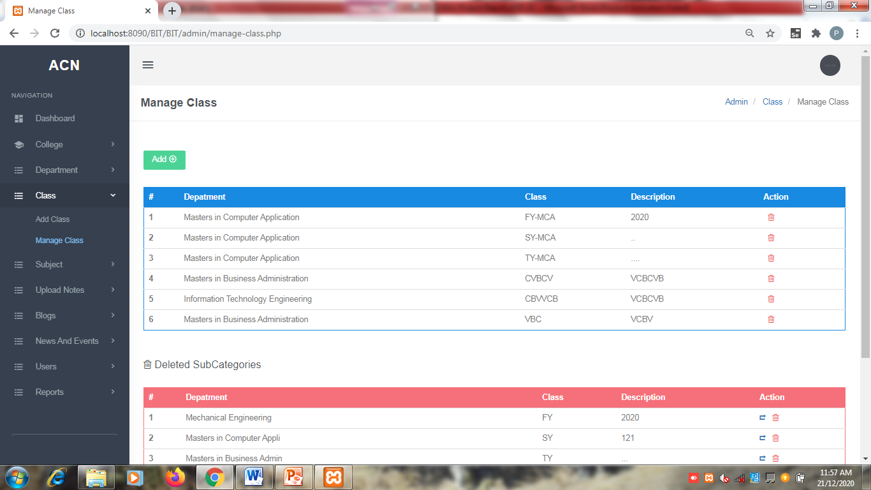
ADD/MANAGE DETAILS OF CLASS:

Slide 32
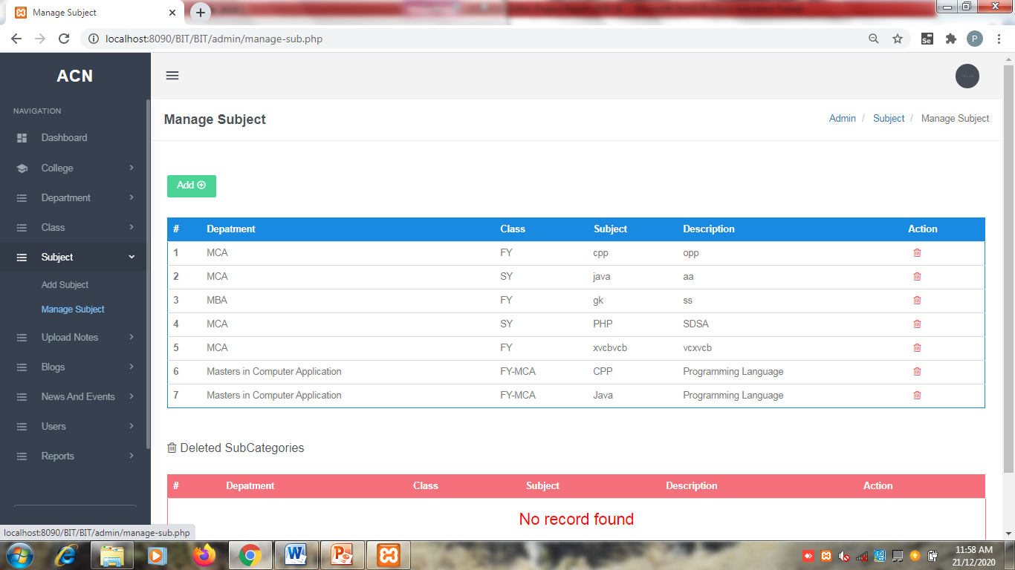
ADD/MANAGE DETAILS OF SUBJECT:

Slide 33
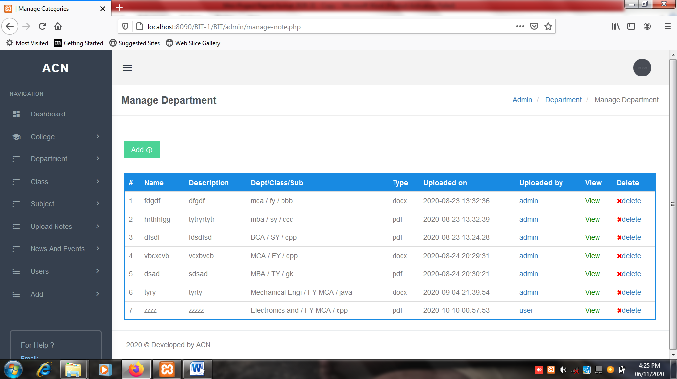
MANAGE NOTES:

Slide 34
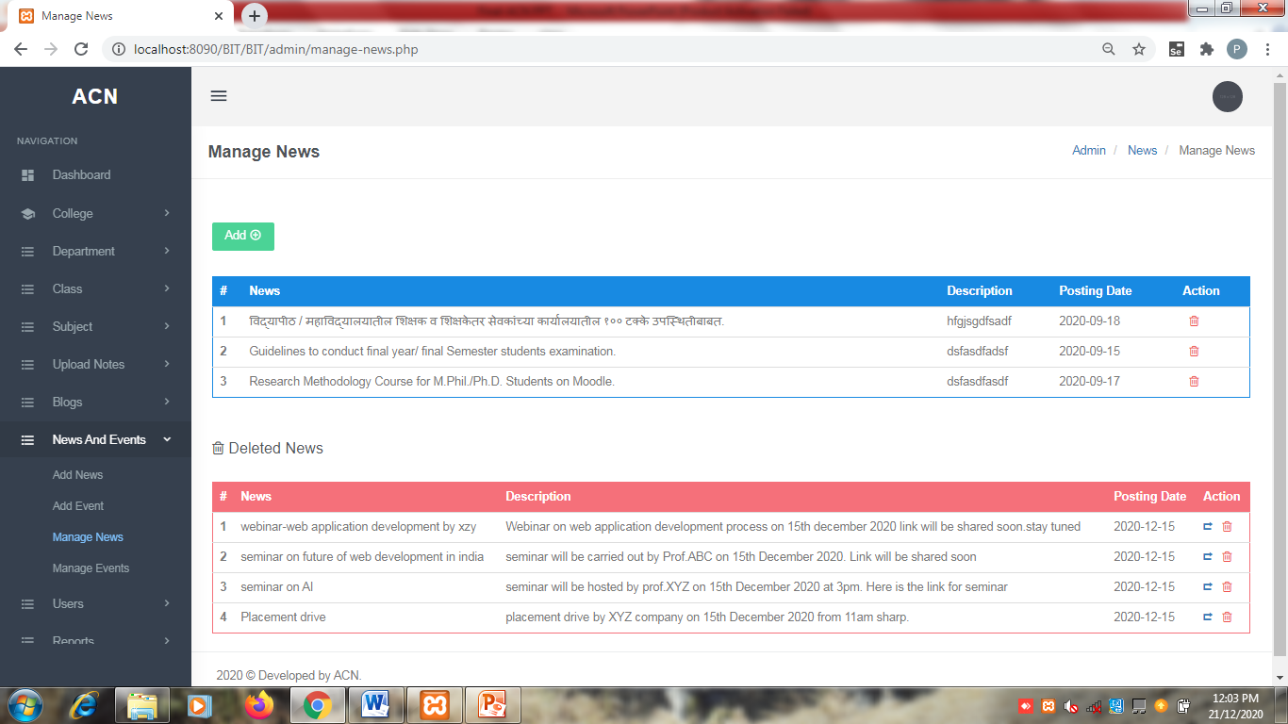
MANAGE NEWS:

Slide 35

MANAGE EVENTS:

Slide 36
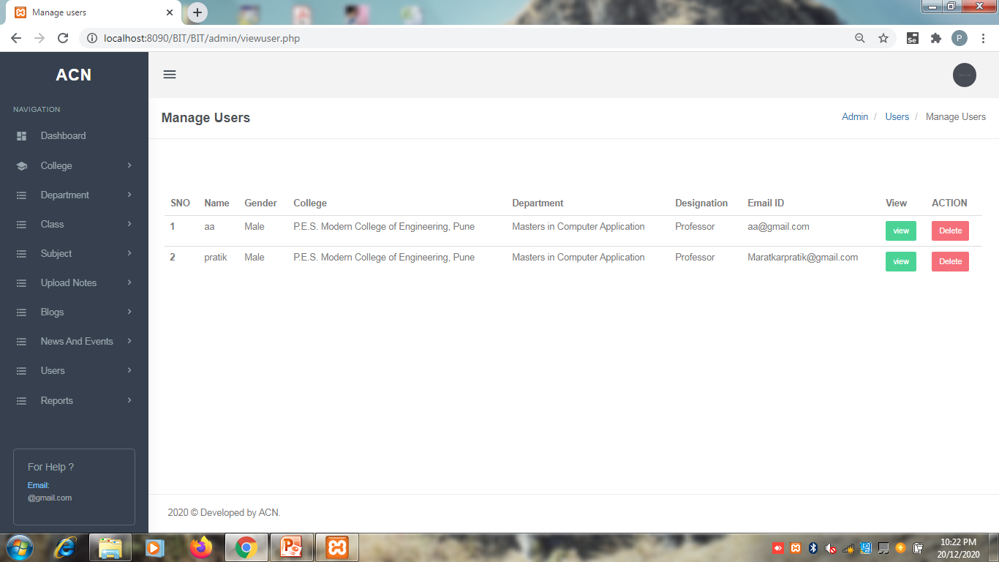
MANAGE USER:

Slide 37
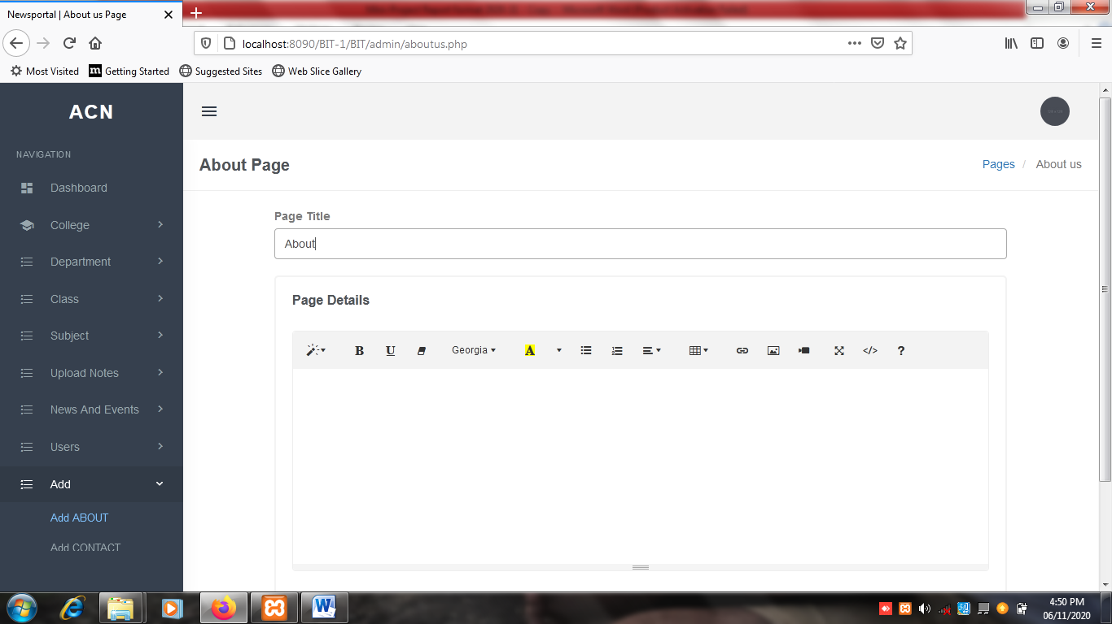
ADD INTO ABOUT PAGE:

Slide 38
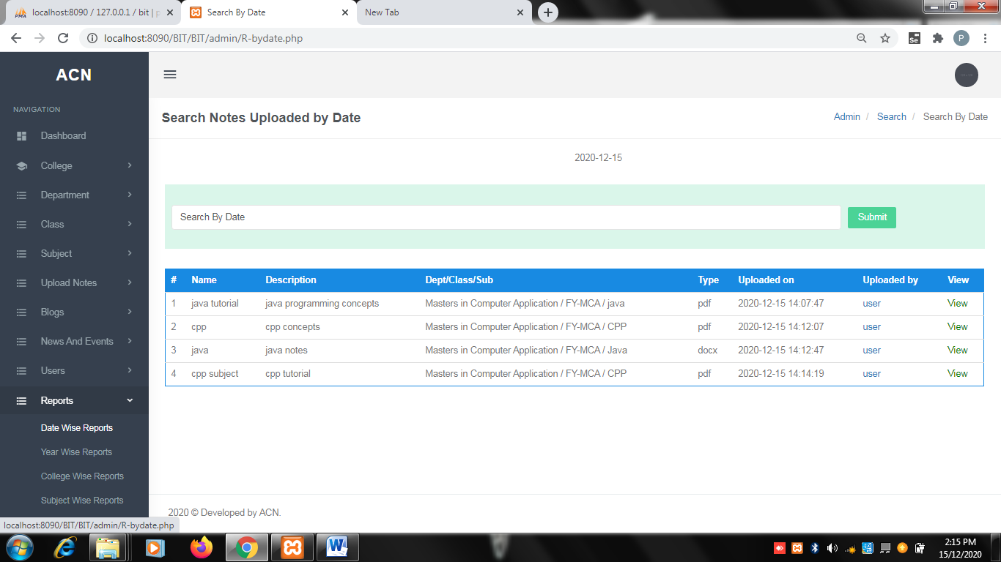
REPORTS
Search report for notes by date of upload:

Slide 39
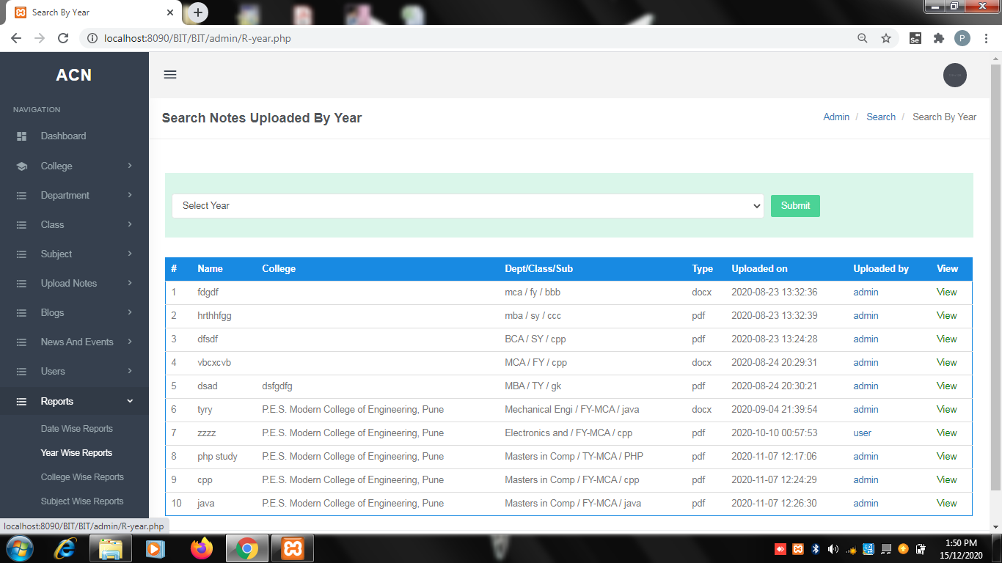
Search report for notes by year of upload:

Slide 40
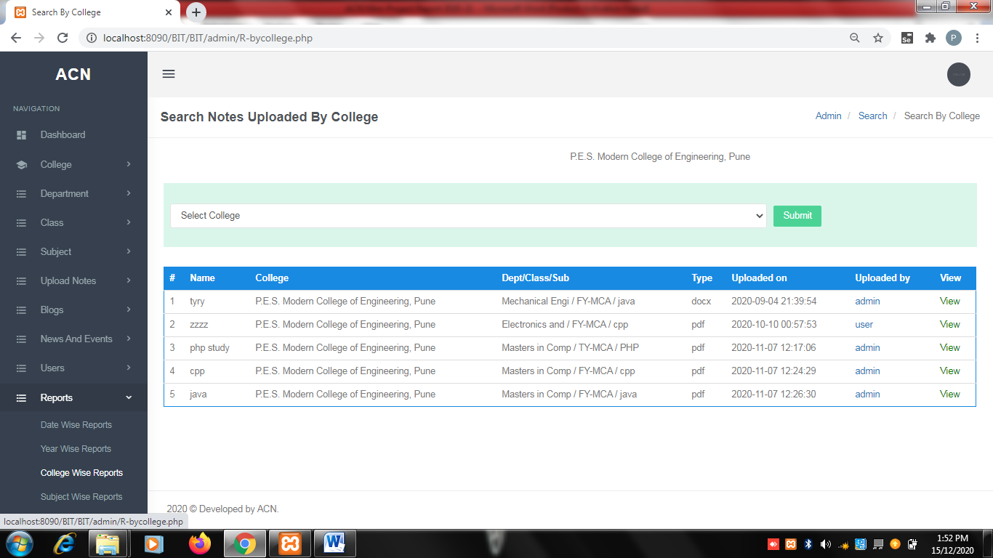
Search report for notes by specific college:

Slide 41
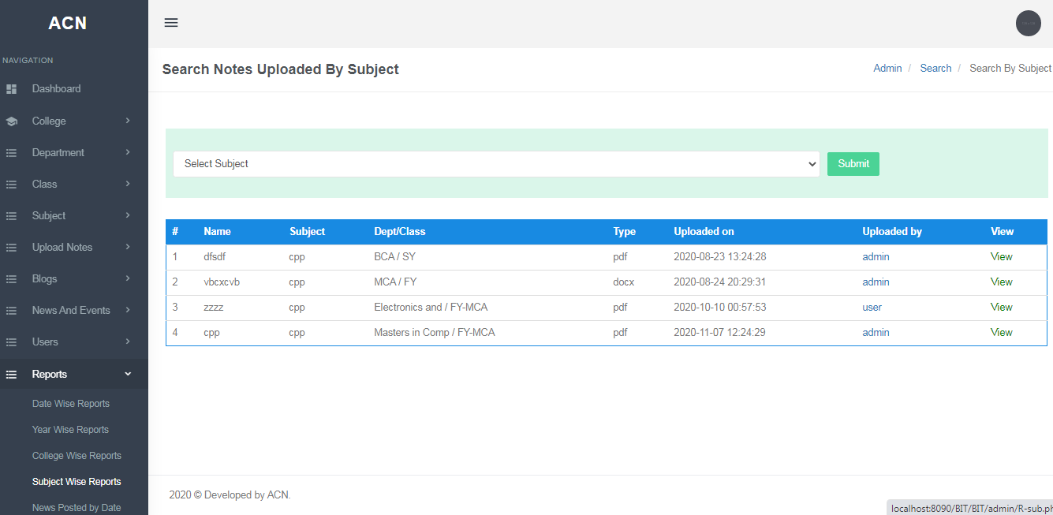
Search report for notes by specifying subject:

Slide 42
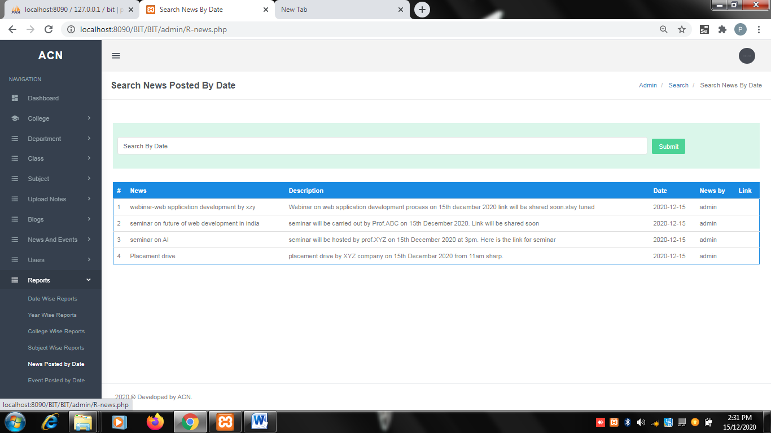
Search report for News by date of upload:

Slide 43
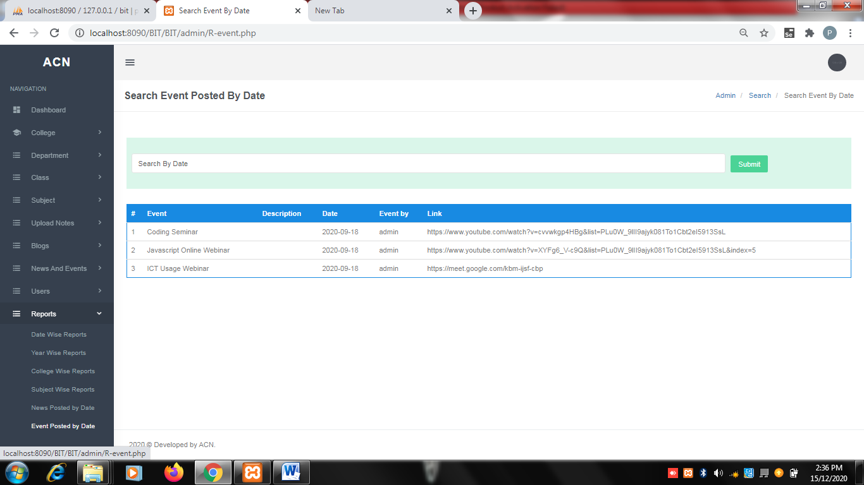
Search report for Events by date of upload:

Slide 44
TEST CASES
User Registration Module
Test Case ID | Test Case Description | Steps | Test Type | Test Data | Expected Result | Actual Result | Status
TC01 | To check functionality of registration page | S1 | Invalid data | Leave all fields empty | It should display meaningful error message | “please fillout this fields” message appeared | PASS
 |  | S2 | Invalid data | Leave few fields empty | It should display meaningful error message | “please fillout this fields” message appeared | PASS
 |  | S3 | Valid data | Fill out all the fields correctly | It should isplay meaningful message | “Successfully registered“ message displayed | PASS

Slide 45
Teacher Login Module:
Test Case ID | Test Case Description | Steps | Test Type | Test Data | Expected Result | Actual Result | Status
TC02 | To check functionality of Teacher login page | S1 | Invalid data | Enter wrong Username & wrong Password | It should display meaningful error message | Wrong Username/ Password | PASS
 |  | S2 | Invalid data | Enter wrong Username & correct Password | It should display meaningful error message | “user not registered with us” error message | PASS
 |  | S3 | Invalid data | Enter correct Username & wrong Password | It should display meaningful error message | “wrong password” message displayed | PASS
 |  | S4 | Invalid data | Enter correct Username & leave Password field empty | It should display meaningful error message | “please fillout this fields” message appeared | PASS
 |  | S5 | Invalid data | Leave empty Username field & correct Password | It should display meaningful error message | “please fillout this fields” message appeared | PASS
 |  | S6 | Valid data | Enter correct Username & correct Password | It should display Dashboard of teacher panel | Displayed dashboard of teacher panel | PASS

Slide 46
Admin Login Module:
Test Case ID | Test Case Description | Steps | Test Type | Test Data | Expected Result | Actual Result | Status
TC03 | To check functionality of Admin login page | S1 | Invalid data | Enter wrong Username & wrong Password | It should display meaningful error message | Wrong Username/ Password | PASS
 |  | S2 | Invalid data | Enter wrong Username & correct Password | It should display meaningful error message | “user not registered with us” error message | PASS
 |  | S3 | Invalid data | Enter correct Username & wrong Password | It should display meaningful error message | “wrong password” message displayed | PASS
 |  | S4 | Invalid data | Enter correct Username & leave Password field empty | It should display meaningful error message | “please fillout this fields” message appeared | PASS
 |  | S5 | Invalid data | Leave empty Username field & correct Password | It should display meaningful error message | “please fillout this fields” message appeared | PASS
 |  | S6 | Valid data | Enter correct Username & correct Password | It should display Dashboard of teacher panel | Displayed dashboard of teacher panel | PASS

Slide 47
RESOURCE UPLOADS:
Test Case Name | Test Case Description | Steps | Test Type | Test Data | Expected Result | Actual Result | Status
TC04 | To check functionality of uploading of documents/ files | S1 | Invalid data- Enter document type other than 'pdf','doc','ppt','txt','zip’. | Enter document with ‘xml’ extension | Meaningful error message should be displayed | “Incorrect file format” | PASS
 |  | S2 | Valid data-Enter document type from below formats 'pdf','doc','ppt','txt','zip’. | Enter document with ‘pdf’ extension | File must get uploaded and Meaningful Message should be displayed | File uploaded and “Successfully Uploaded” message displayed. | PASS
 |  | S3 | Invalid data- Enter document of size more than 30 mb | Zip file of size 144 mb | File must not get uploaded and Meaningful Error Message should be displayed | Upload error and “File Size exceeded” message displayed. | PASS
 |  |  | Valid data- Enter document of size more than 30 mb | Zip file of size 29 mb | File must get uploaded and Meaningful Message should be displayed | File uploaded and “Successfully Uploaded” message displayed. | PASS

Slide 48
CONCLUSION
The Tourism Management System will manage all the shared content effectively. The data shared here will be secure as well as easily available. Manually maintaining record or data of different persons/tours is a difficult job thus here TMS comes in the business where all the data will be managed. Due to this person who really wants to explore the world and places they will be having a platform.
The system will help maintain good relations with the others also. As system is providing upcoming tours information it keeps you updated with the outer world. The system is easy to use also time efficient.

Slide 49
REFERENCES
https://www.efluniversity.ac.in
https://studyportals.com
https://stackoverflow.com
https://www.w3schools.com

Slide 50
THANK YOU

